Slide 1
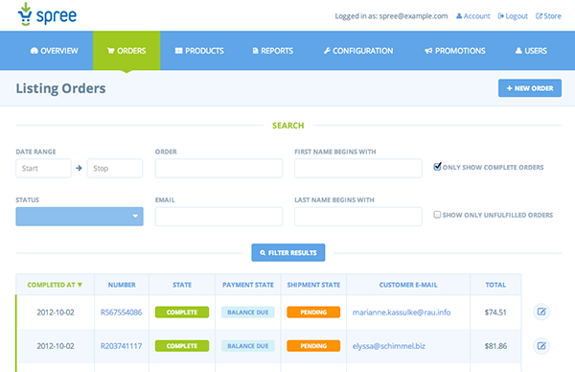
Projects Using Ruby on Rails
Project 5 Intro – Spree Ecommerce Site

Slide 2
Project Description & Features
Full featured ecommerce website
User management
Order & Product management
Custom layouts & overrides
PayPal gateway extension
Postgresql database

Slide 3
Project Sections
Section 1: Project Introduction
Section 2: Application & PostgreSQL Setup
Section 3: Spree Installation & Setup
Section 4: Themes & Overriding Assets
Section 5: Overriding Views With Deface
Section 6: Add PayPal Gateway

Slide 4
What You’ll Learn
Installing & configuring PostgreSQL
Pg gem setup
Spree ecommerce system
MVC framework fundamentals
CRUD operations through Spree
Extensions & payment gateways

Slide 5
Let’s Do It!
Let’s go code!

